Slide 1


ACCT 2003 Intermediate Financial Accounting 中级财务会计
THE HITSZ
SCHOOL OF ECONOMICS
AND MANAGEMENT
授课人：墙伟
2024.10.16

Slide 2

LEARNING OBJECTIVES
CHAPTER 12
Intangible Assets
无形资产
After studying this chapter, you should be able to:
1. Discuss the characteristics, valuation, and amortization of intangible assets.
2. Describe the accounting for various types of intangible assets.
3. Explain the accounting issues for recording goodwill.
4. Identify impairment procedures and presentation requirements for intangible assets.
5. Describe the accounting and presentation for research and development and similar costs.

Slide 3
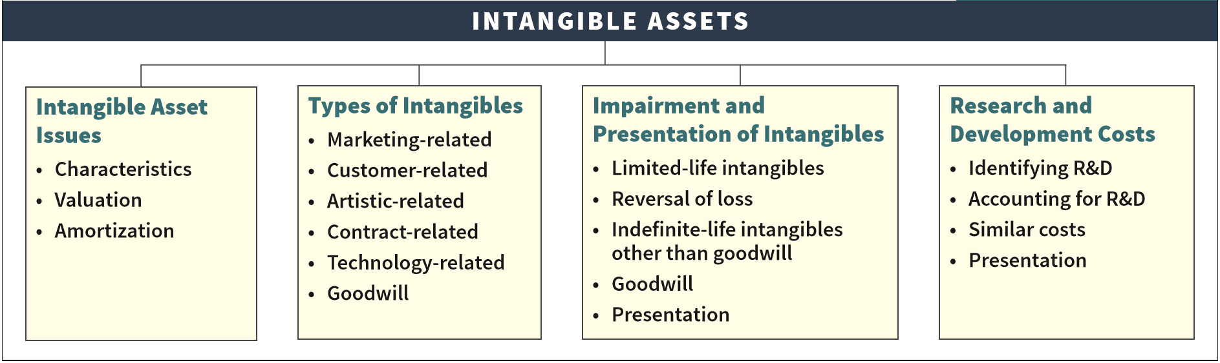
PREVIEW OF CHAPTER 12
Intermediate Accounting
IFRS 4th Edition
Kieso ● Weygandt ● Warfield

Slide 4
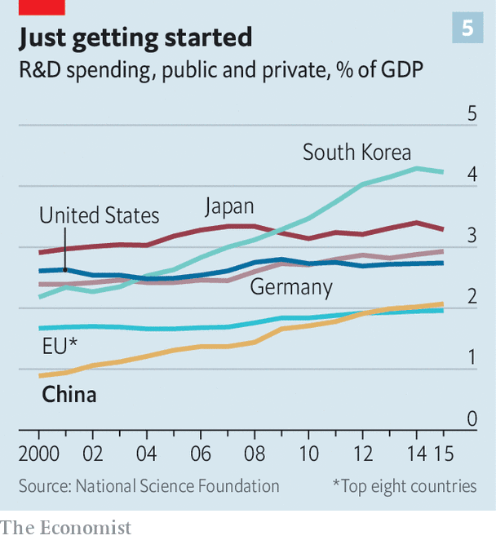
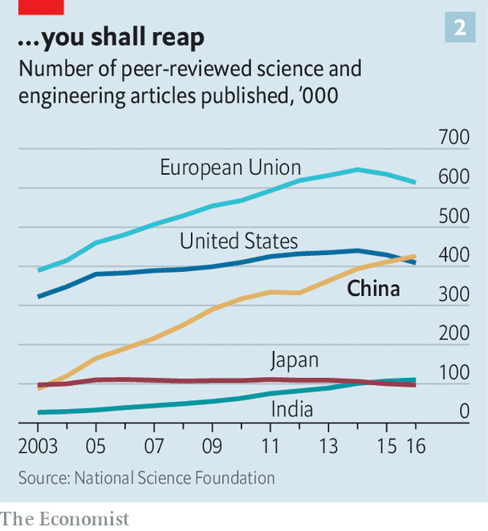
R&D spending 研发支出

Slide 5
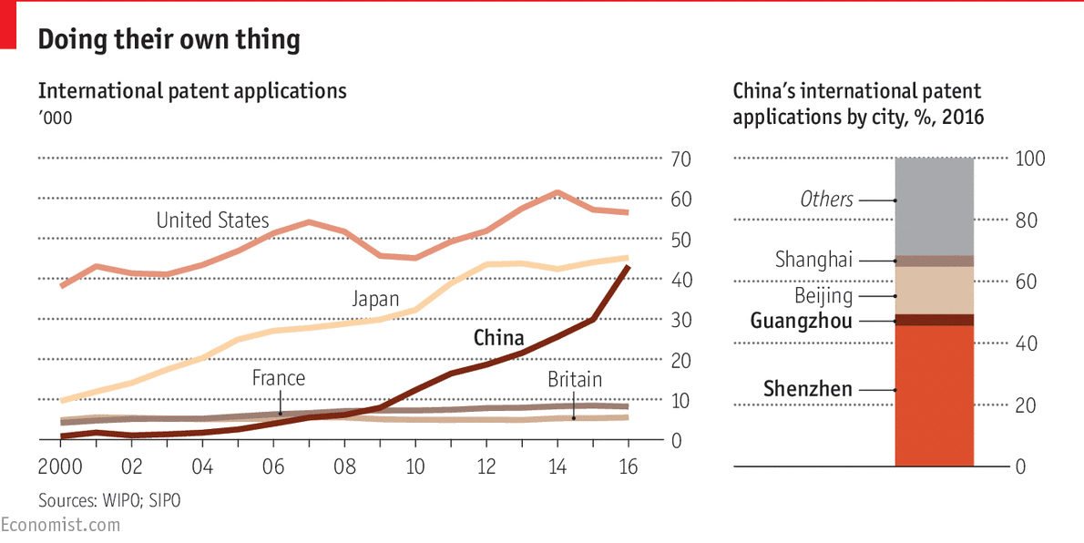
Patent applications 专利申请

Slide 6
LEARNING OBJECTIVE 1
Discuss the characteristics, valuation, and amortization of intangible assets.

Slide 7
Intangible Asset Issues 无形资产问题
Characteristics 特征
Christian Dior’s (FRA) most important asset is its brand image, not its store ﬁxtures.
Identifiable. 可辨认
Lack physical existence. 缺乏实物形态
Not monetary assets. 非货币资产
Normally classified as non-current asset.
Common types of intangibles:
Marketing-related. 市场
Customer-related. 客户
Artistic-related. 艺术
Contract-related. 合同
Technology-related. 技术
Goodwill. 商誉
LO 1
Notes:
(L.O. 1) The characteristics of intangible assets are: (1) they are identifiable, (2) they lack physical existence, and (3) they are not monetary assets. The most common types of intangibles reported are patents, copyrights, franchises, licenses, trademarks, trade names, and goodwill.
They are identifiable. To be identifiable, an intangible asset must either be separable from the company (can be sold or transferred), or it arises from a contractual or legal right from which economic benefits will flow to the company. IFRS also prohibits recognition of intangible assets such as internally generated brands, mastheads, and customer lists. These expenditures are similar to other costs to develop the business as whole; therefore, they do not meet the identifiable criterion.
They lack physical existence. Tangible assets such as property, plant, and equipment have physical form. Intangible assets, in contrast, derive their value from the rights and privileges granted to the company using them.
They are not monetary assets. Assets such as bank deposits, accounts receivable, and long-term investments in bonds and shares also lack physical substance. However, monetary assets derive their value from the right (claim) to receive cash or cash equivalents in the future. Monetary assets are not classified as intangibles.

Slide 8
Intangible Asset Issues 无形资产问题
Valuation 计价
Purchased Intangibles 外购无形资产
Recorded at cost.
Includes all acquisition costs plus expenditures to make the intangible asset ready for its intended use.
Typical costs include:
Purchase price. 购买价款
Legal fees. 法律费用
Other incidental expenses. 其他杂费
LO 1
Notes:
Companies record at cost intangibles purchased from another party. Cost includes all acquisition costs plus expenditures to make the intangible asset ready for its intended use. Typical costs include purchase price, legal fees, and other incidental expenses.
Sometimes companies acquire intangibles in exchange for shares or other assets. In such cases, the cost of the intangible is the fair value of the consideration given or the fair value of the intangible received, whichever is more clearly evident.

Slide 9
Valuation 计价
Internally Created Intangibles 内部自创无形资产
Might include patents, computer software, copyrights, and trademarks.
Companies expense all research phase costs 研究支出 and some development phase costs 开发支出.
Certain development costs are capitalized once economic viability criteria 经济可行性 are met.
IFRS identifies several specific criteria that must be met before development costs are capitalized.
LO 1
Notes:
Businesses frequently incur costs on a variety of intangible resources, such as scientific or technological knowledge, market research, intellectual property, and brand names. These costs are commonly referred to as research and development (R&D) costs.
Intangible assets that might arise from these expenditures include patents, computer software, copyrights, and trademarks.
In essence, economic viability indicates that the project is far enough along in the process such that the economic benefits of the R&D project will flow to the company. Therefore, development costs incurred from that point forward meet the recognition criteria and should be recorded as an intangible asset

Slide 10
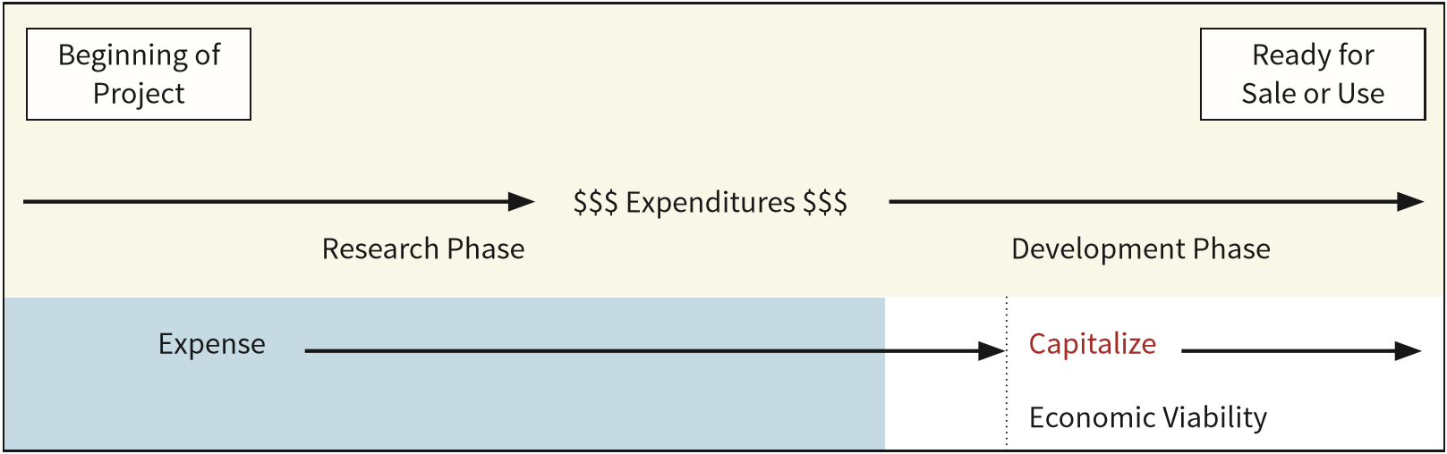
Intangible Asset Issues
Internally Created Intangibles 内部自创无形资产
ILLUSTRATION 12.1
Research and Development Stages
开发支出资本化期间
条件：研发项目具有经济可行性
LO 1
Notes:
For example, HUAWEI investing R&D expenditures to generate 5G patents.
In determining the accounting for these costs, HUAWEI must determine whether its R&D project is at a sufficiently advanced stage to be considered economically viable.
To perform this assessment, HUAWEI evaluates costs incurred during the research phase and the development phase.
As indicated, all costs incurred in the research phase are expensed as incurred. Once a project moves to the development phase, certain development costs are capitalized.
Specifically, development costs are capitalized when certain criteria are met, indicating that an economically viable intangible asset will result from the R&D project.
In essence, economic viability indicates that the project is far enough along in the process such that the economic benefits of the R&D project will flow to the company.

Slide 11
Intangible Asset Issues 无形资产问题
Amortization of Intangibles 摊销
Limited-Life Intangibles 有限使用寿命无形资产
Amortize by systematic charge to expense over useful life.
Amortization expense should reﬂect the pattern in which the company consumes or uses up the asset.
Credit asset account or accumulated amortization. 累计摊销
Amortization should be cost less residual value.
Companies must evaluate the limited-life intangibles annually for impairment.
LO 1
Notes:
The allocation of the cost of intangible assets in a systematic way is called amortization.
Intangibles have either a limited (finite) useful life or an indefinite useful life. For example, a company like Disney (USA) has both types of intangibles. Disney amortizes its limited-life intangible assets (e.g., copyrights on its movies and licenses related to its branded products). It does not amortize indefinite-life intangible assets (e.g., the Disney trade name or its Internet domain name).
The useful life should reflect the periods over which these assets will contribute to cash flows.
The expected use of the asset by the company.
The effects of obsolescence, demand, competition, and other economic factors. Examples include the stability of the industry, known technological advances, legislative action that results in an uncertain or changing regulatory environment, and expected changes in distribution channels.
Any provisions (legal, regulatory, or contractual) that enable renewal or extension of the asset’s legal or contractual life without substantial cost. This factor assumes that there is evidence to support renewal or extension. Disney also must be able to accomplish renewal or extension without material modifications of the existing terms and conditions.
The level of maintenance expenditure required to obtain the expected future cash flows from the asset. For example, a material level of required maintenance in relation to the carrying amount of the asset may suggest a very limited useful life.
Any legal, regulatory, or contractual provisions that may limit the useful life.
The expected useful life of another asset or a group of assets to which the useful life of the intangible asset may relate (such as lease rights to a studio lot). [3]
The amount of an intangible asset to be amortized should be its cost less residual value. The residual value is assumed to be zero, unless at the end of its useful life the intangible asset has value to another company.
IFRS requires companies to assess the estimated residual values and useful lives of intangible assets at least annually.
Companies must also evaluate the limited-life intangibles annually to determine if there is an indication of impairment. If there is indication of impairment, an impairment test is performed. An impairment loss should be recognized for the amount that the carrying amount of the intangible is greater than the recoverable amount.

Slide 12
Intangible Asset Issues 无形资产问题
Amortization of Intangibles 摊销
Limited-Life Intangibles-useful life
The expected use of the asset by the company.
The effects of obsolescence, demand, competition, and other economic factors.
Any provisions (legal, regulatory, or contractual) that enable renewal or extension of the asset’s legal or contractual life without substantial cost. This factor assumes that there is evidence to support renewal or extension.
The level of maintenance expenditure required to obtain the expected future cash flows from the asset.
Any legal, regulatory, or contractual provisions that may limit the useful life.
The expected useful life of another asset or a group of assets to which the useful life of the intangible asset may relate (such as lease rights to a studio lot).
LO 1
Notes:
The allocation of the cost of intangible assets in a systematic way is called amortization.
Intangibles have either a limited (finite) useful life or an indefinite useful life. For example, a company like Disney (USA) has both types of intangibles. Disney amortizes its limited-life intangible assets (e.g., copyrights on its movies and licenses related to its branded products). It does not amortize indefinite-life intangible assets (e.g., the Disney trade name or its Internet domain name).
The useful life should reflect the periods over which these assets will contribute to cash flows.
The expected use of the asset by the company.
The effects of obsolescence, demand, competition, and other economic factors. Examples include the stability of the industry, known technological advances, legislative action that results in an uncertain or changing regulatory environment, and expected changes in distribution channels.
Any provisions (legal, regulatory, or contractual) that enable renewal or extension of the asset’s legal or contractual life without substantial cost. This factor assumes that there is evidence to support renewal or extension. Disney also must be able to accomplish renewal or extension without material modifications of the existing terms and conditions.
The level of maintenance expenditure required to obtain the expected future cash flows from the asset. For example, a material level of required maintenance in relation to the carrying amount of the asset may suggest a very limited useful life.
Any legal, regulatory, or contractual provisions that may limit the useful life.
The expected useful life of another asset or a group of assets to which the useful life of the intangible asset may relate (such as lease rights to a studio lot). [3]
The amount of an intangible asset to be amortized should be its cost less residual value. The residual value is assumed to be zero, unless at the end of its useful life the intangible asset has value to another company.
IFRS requires companies to assess the estimated residual values and useful lives of intangible assets at least annually.
Companies must also evaluate the limited-life intangibles annually to determine if there is an indication of impairment. If there is indication of impairment, an impairment test is performed. An impairment loss should be recognized for the amount that the carrying amount of the intangible is greater than the recoverable amount.

Slide 13
Intangible Asset Issues 无形资产问题
Amortization of Intangibles 摊销
Indefinite-Life Intangibles 使用寿命不确定的无形资产
No foreseeable limit on time the asset is expected to provide cash flows.
No amortization.
Must test indefinite-life intangibles for impairment at least annually.
LO 1
Notes:
An indefinite life means that there is no foreseeable limit on the period of time over which the intangible asset is expected to provide cash flows.
A company does not amortize an intangible asset with an indefinite life.
Companies also must test indefinite-life intangibles for impairment at least annually. The impairment test for indefinite-life intangibles is similar to the one for limited-life intangibles.

Slide 14
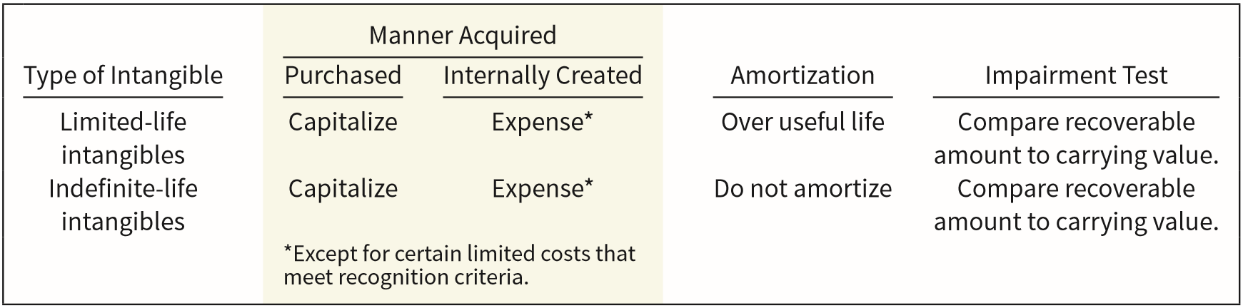
Intangible Asset Issues 无形资产问题
Amortization of Intangibles 摊销
ILLUSTRATION 12.2
Accounting Treatment for Intangibles
LO 1

Slide 15
LEARNING OBJECTIVE 2
Describe the accounting for various types of intangible assets.

Slide 16
Types of Intangible
Assets 无形资产的种类
Six Major Categories:
Marketing-related. 市场
Customer-related. 客户
Artistic-related. 艺术
Contract-related. 合同
Technology-related. 技术
Goodwill. 商誉
LO 2

Slide 17
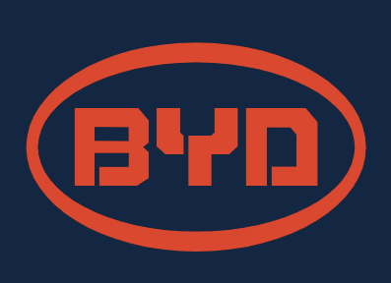




Types of Intangible Assets 无形资产种类
Marketing-Related Intangible Assets
Examples:
Trademarks 商标 or trade names 商品名, newspaper mastheads, Internet domain names, and non-competition agreements.
Under common law, the right to use a trademark or trade name rests exclusively with the original user as long as the original user continues to use it.
Capitalize purchase price.
LO 2
Notes:
Marketing-related intangible assets are those assets primarily used in the marketing or promotion of products or services. Examples are trademarks or trade names, newspaper mastheads, Internet domain names, and non-competition agreements.
For example, in the United States, registration with the U.S. Patent and Trademark Office provides legal protection for an indefinite number of renewals for periods of 10 years each. Therefore, a company that uses an established trademark or trade name may properly consider it to have an indefinite life and does not amortize its cost.
If a company buys a trademark or trade name, it capitalizes the cost at the purchase price. If a company develops a trademark or trade name, it capitalizes costs related to securing it, such as attorney fees, registration fees, design costs, and consulting fees.

Slide 18
Types of Intangible Assets
Marketing-Related Intangible Assets
Examples:
Trademarks 商标 or trade names 商品名, newspaper mastheads, Internet domain names, and non-competition agreements.
Capitalizes costs related to securing it, such as attorney fees, registration fees, design costs, and consulting fees. However, it excludes research costs and development costs that do not meet recognition criteria.
No amortization.
LO 2
Notes:
Marketing-related intangible assets are those assets primarily used in the marketing or promotion of products or services. Examples are trademarks or trade names, newspaper mastheads, Internet domain names, and non-competition agreements.
For example, in the United States, registration with the U.S. Patent and Trademark Office provides legal protection for an indefinite number of renewals for periods of 10 years each. Therefore, a company that uses an established trademark or trade name may properly consider it to have an indefinite life and does not amortize its cost.
If a company buys a trademark or trade name, it capitalizes the cost at the purchase price. If a company develops a trademark or trade name, it capitalizes costs related to securing it, such as attorney fees, registration fees, design costs, and consulting fees.

Slide 19

单选题
1分
When a company develops a trademark the costs directly related to securing it should generally be capitalized. Which of the following costs associated with acquiring a trademark would not be allowed to be capitalized?
此题未设置答案，请点击右侧设置按钮
A
Attorney fees
B
Consulting fees.
C
Research and development fees.
D
Design costs.
Submit

Slide 20
What Do The Numbers Mean? Keep Your Hands Off My Intangible!
Companies go to great extremes to protect their valuable intangible assets. Consider how the creators of the highly successful game Trivial Pursuit protected their creation. First, they copyrighted the 6,000 questions that are at the heart of the game. Then, they shielded the Trivial Pursuit name by applying for a registered trademark. As a third mode of protection, they obtained a design patent on the playing board’s design as a unique graphic creation.
Another more recent example is the case of Converse (owned by Nike (USA)) and its eﬀorts to protect its classic Chuck Taylor trademark. Converse accused 31 companies (including U.S. companies such as Wal-Mart Stores, Inc., Kmart, and Skechers) of trademark infringement for co-opting its widely recognizable Chuck
Taylor® sneakers. While Converse is suing for monetary damages, its main goal is to get these imposters oﬀ store shelves. The company went as far as ﬁ ling a separate complaint with the International Trade Commission to stop any shoes considered to be counterfeit from entering the country. That Converse (Nike) is going to these ends to protect its trademark is understandable given that Nike reinvigorated the brand by expanding the franchise, introducing more colors and styles, and helping to push All Stars® into overseas markets.
Source: “Converse Sues to Product Its Chuck Taylor All Stars,” The New Work Times (October 14, 2014).
LO 2

Slide 21

单选题
1分
Quick Check #1
It is not uncommon for companies to incur legal fees and other costs to protect their valuable trade names and other intangible assets. How to account for these subsequent expenditures?
此题未设置答案，请点击右侧设置按钮
A
Capitalization
B
Expense
Submit
Notes:
The IASB indicates that subsequent expenditures likely only maintain the expected future economic benefits of the existing intangible asset, rather than enhancing its value or creating a new intangible asset.

Slide 22
Types of Intangible Assets 无形资产种类
Customer-Related Intangible Assets 客户相关
Examples:
Customer lists 客户名单, order or production backlogs 订单和生产日志, and both contractual and non-contractual customer relationships 合同与非合同性客户关系.
Capitalize acquisition costs.
Amortized to expense over useful life.
LO 2
Notes:
Customer-related intangible assets result from interactions with outside parties. Examples include customer lists, order or production backlogs, and both contractual and non-contractual customer relationships.

Slide 23
Types of Intangible Assets
Illustration: Green Market AG acquires the customer list of a large newspaper for €6,000,000 on January 1, 2019. Green Market expects to benefit from the information evenly over a three-year period. Record the purchase of the customer list and the amortization of the customer list for each year on the straight-line basis.
Date | Account | Debit | Credit
Jan. 1
2019
Customer List 无形资产——客户名单 6,000,000
Cash 银行存款 6,000,000
Dec. 31
2019
2020
2021
Amortization Expense 2,000,000
管理费用——摊销费用——客户名单
Accumulated Amortization 2,000,000
累计摊销
LO 2
Notes:
The preceding example assumed no residual value for the customer list. But what if Green Market determines that it can sell the list for €60,000 to another company at the end of three years?

Slide 24



Types of Intangible Assets
Artistic-Related Intangible Assets
Examples:
Plays, literary works, musical works, pictures, photographs, and video and audiovisual material.
Copyright 版权 granted for the life of the creator plus 70 years （50 years in China).
Capitalize costs of acquiring and defending.
Companies must expense all research costs and any development costs not meeting recognition criteria that lead to a copyright as those costs are incurred.
Amortized to expense over useful life if less than the legal life.
Mickey Mouse
LO 2
Notes:
Artistic-related intangible assets involve ownership rights to plays, literary works, musical works, pictures, photographs, and video and audiovisual material. Copyrights protect these ownership right intos.
A copyright is a government-granted right that all authors, painters, musicians, sculptors, and other artists have in their creations and expressions. A copyright is granted for the life of the creator plus 70 years. It gives the owner or heirs the exclusive right to reproduce and sell an artistic or published work. Copyrights are not renewable.
Companies capitalize the costs of acquiring a copyright. They amortize any capitalized costs over the useful life of the copyright if less than its legal life (life of the creator plus 70 years).
Companies must expense all research costs and any development costs not meeting recognition criteria that lead to a copyright as those costs are incurred.

Slide 25



Types of Intangible Assets
Contract-Related Intangible Assets 合同相关
Examples:
Franchise 特许经营权 and licensing agreements 许可协议, construction permits 建造许可证, broadcast rights 广播权, and service or supply contracts 服务和供应合同.
Franchise 特许经营权 (or license) with a limited life should be amortized as operating expense over the life of the franchise.
Franchise with an indefinite life should be carried at cost and not amortized.
LO 2
Notes:
Contract-related intangible assets represent the value of rights that arise from contractual arrangements. Examples are franchise and licensing agreements, construction permits, broadcast rights, and service or supply contracts.
A franchise is a contractual arrangement under which the franchisor grants the franchisee the right to sell certain products or services, to use certain trademarks or trade names, or to perform certain functions, usually within a designated geographical area.
Another type of franchise arrangement, granted by a governmental body, permits a business to use public property in performing its services. Examples are the use of city streets for a bus line or taxi service; the use of public land for telephone, electric, or cable television lines; and the use of airwaves for radio or TV broadcasting.
The company securing the franchise or license carries an intangible asset account (entitled Franchises or Licenses) on its books, only when it can identify costs with the acquisition of the operating right.
Annual payments made under a franchise agreement should be entered as operating expenses in the period in which they are incurred. These payments do not represent an asset since they do not relate to future rights to use the property.

Slide 26




Types of Intangible Assets
Technology-Related Intangible Assets 技术相关
Examples:
Patented technology 技术专利 and trade secrets 商业机密granted by a government body.
Patent gives holder exclusive use for a period of 20 years.
Capitalize costs of purchasing a patent, and other costs incurred in connection with securing a patent, such as registration and attorneys’ fees.
Expense all R&D costs and any development costs incurred before achieving economic viability.
Amortize over legal life or useful life, whichever is shorter.
LO 2
Notes:
Technology-related intangible assets relate to innovations or technological advances. Examples are patented technology and trade secrets granted by a governmental body.
In many countries, a patent gives the holder exclusive right to use, manufacture, and sell a product or process for a period of 20 years without interference or infringement by others.
The two principal kinds of patents are product patents, which cover actual physical products, and process patents, which govern the process of making products.
If a company like Samsung (KOR) purchases a patent from an inventor, the purchase price represents its cost. Samsung can capitalize other costs incurred in connection with securing a patent, such as registration and attorneys’ fees.
However, it must expense all research costs and any development costs incurred before achieving economic viability related to the development of the product, process, or idea that it subsequently patents.
Companies should amortize the cost of a patent over its legal life or its useful life (the period in which benefits are received), whichever is shorter.

Slide 27
Types of Intangible Assets
Illustration: Harcott Co. incurs $180,000 in legal costs on January 1, 2019, to successfully defend a patent. The patent’s useful life is 10 years, amortized on a straight-line basis. Harcott records the legal fees and the amortization at the end of 2019 as follows.
Date | Account | Debit | Credit
Jan. 1
Patents 无形资产——专利权 180,000
Cash 银行存款 180,000
Dec. 31
Amortization Expense- Patent 18,000
管理费用——摊销费用——专利权
Accumulated Amortization 18,000
累计摊销
Patent Amortization Expense =
($180,000 ÷ 10) = $18,000
LO 2
Notes:
Amortization expense should reflect the pattern, if reliably determined, in which a company uses up the patent.
However, companies often make small modifications or additions that lead to a new patent. For example, AstraZeneca plc (GBR) filed for additional patents on minor modifications to its heartburn drug, Prilosec. The effect may be to extend the life of the old patent. If the new patent provides essentially the same benefits, AstraZeneca can apply the unamortized costs of the old patent to the new patent.
Alternatively, if a patent becomes impaired because demand drops for the product, the asset should be written down or written off immediately to expense.

Slide 28
单选题
1分
Elena Corporation purchased a patent for a new product from the inventor for £180,000 on January 1, 2020. It had a useful life of 10 years. Elena made minor modifications to the patent and spent additional registration and legal fees of £48,000 on January 2, 2022, extending the useful life of the old patent to 12 remaining years. What amount should be reported for patent amortization expense on 12/31/22?
A
£15,000.
B
£18,000.
C
£16,000.
D
£14,400.
提交

Slide 29
LEARNING OBJECTIVE 3
Explain the accounting issues for recording goodwill.

Slide 30
Types of Intangible Assets
Goodwill 商誉
Conceptually, represents the future economic benefits arising from the other assets acquired in a business combination that are not individually identified and separately recognized.
Only recorded when an entire business is purchased.
Goodwill is measured as the ...
excess of cost over the fair value of the identifiable net assets (assets less liabilities) acquired.
Internally created goodwill should not be capitalized.
LO 3
Notes:
Although companies may capitalize certain costs incurred in developing specifically identifiable assets such as patents and copyrights, the amounts capitalized are generally insignificant. But companies do record material amounts of intangible assets when purchasing intangible assets, particularly in situations involving a business combination.
In many business combinations, the purchasing company records goodwill. Goodwill is measured as the excess of the cost of the purchase over the fair value of the identifiable net assets (assets less liabilities) purchased.

Slide 31
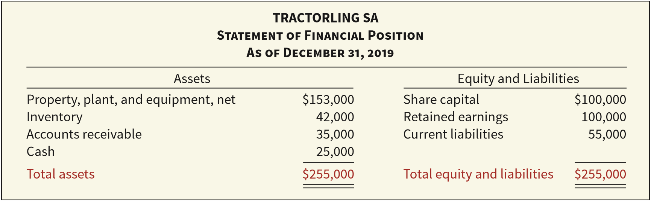
Recording Goodwill 记录商誉
Illustration: Feng, Inc. decides that it needs a parts division to supplement its existing tractor distributorship. The president of Feng is interested in buying Tractorling SA. The illustration presents the statement of financial position of Tractorling SA.
ILLUSTRATION 12.4
Tractorling Statement of Financial Position
LO 3
Notes:
As indicated earlier, goodwill is recorded only when an entire business is purchased. To record goodwill, a company compares the fair value of the net tangible and identifiable intangible assets with the purchase price (cost) of the acquired business.
Goodwill is the residual—the excess of cost over fair value of the identifiable net assets acquired.

Slide 32
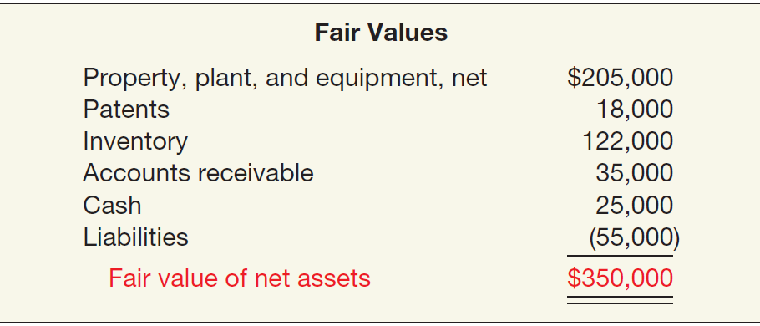
Recording Goodwill
Illustration: Feng investigates Tractorling’s underlying assets to determine their fair values.
ILLUSTRATION 12.5
Fair Value of Tractorling’s Net Assets
Tractorling Company decides to accept Feng’s offer of $400,000. What is the value of the goodwill, if any?
LO 3
Notes:
Since the investigation now determines the fair value of net assets to be $350,000, why would Feng pay $400,000?
Undoubtedly, Tractorling points to its established reputation, good credit rating, top management team, and well-trained employees, as well as synergies and cost savings in the combined entity.

Slide 33
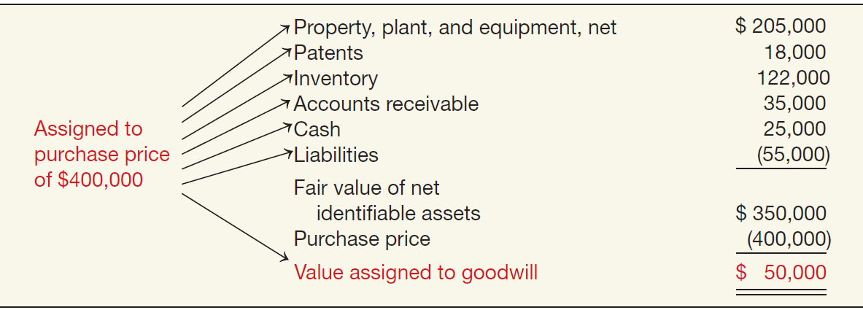
Recording Goodwill
Illustration: Determination of Goodwill.
ILLUSTRATION 12.6
Determination of Goodwill—
Master Valuation Approach
LO 3
Notes:
Goodwill is viewed as one or a group of unidentifiable values (intangible assets), the cost of which “is measured by the difference between the cost of the group of assets or enterprise acquired and the sum of the assigned costs of individual tangible and identifiable intangible assets acquired less liabilities assumed.

Slide 34
Recording Goodwill
Illustration: Feng records this transaction as follows.
Date | Account | Debit | Credit
Property, Plant, and Equipment 205,000
Patents 18,000
Inventory 122,000
Accounts Receivables 35,000
Cash 25,000
Goodwill 商誉 50,000
Liabilities 55,000
Cash 400,000
LO 3

Slide 35
Recording Goodwill
Goodwill Write-Off
Goodwill considered to have an indefinite life.
Should not be amortized.
Only adjust carrying value when goodwill is impaired.
Bargain Purchase
Purchase price less than the fair value of net assets acquired.
Amount is recorded as a gain by the purchaser.
LO 3

Slide 36
LEARNING OBJECTIVE 4
Identify impairment procedures and presentation requirements for intangible assets.

Slide 37
Impairment of Intangible Assets 无形资产减值
An intangible asset is impaired when a company is not able to recover the asset’s carrying amount either through using it or by selling it.
The speciﬁc procedures for recording impairments depend on the type of intangible asset—
limited-life or
indeﬁnite-life (including goodwill).
LO 4

Slide 38
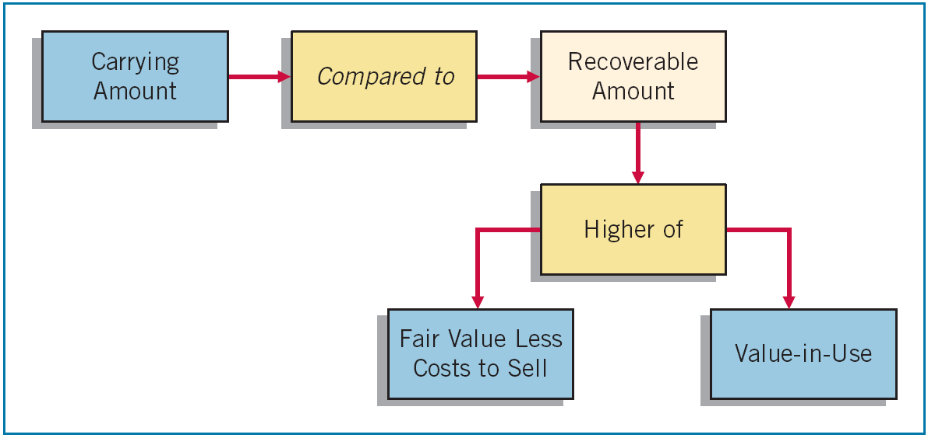
Impairment of Limited-Life Intangibles
The rules that apply to impairments of property, plant, and equipment also apply to limited-life intangibles.
The impairment loss is the carrying amount of the asset less the recoverable amount of the impaired asset.
LO 4
Notes:
At each statement of financial position date, a company should review limited-life intangibles for impairment. If there is an indication that an intangible asset is impaired, the company performs an impairment test: compare the carrying value of the intangible asset to the recoverable amount.
Recall that the recoverable amount is defined as the higher of fair value less costs to sell or value-in-use. Fair value less costs to sell means what the asset could be sold for after deducting costs of disposal. Value-in-use is the present value of cash flows expected from the future use and eventual sale of the asset at the end of its useful life.

Slide 39
Impairment of Limited-Life Intangibles
Fair value less costs to sell means what the asset could be sold for after deducting costs of disposal. Value-in-use is the present value of cash ﬂows expected from the future use and eventual sale of the asset at the end of its useful life.
LO 4
Notes:
The impairment loss is the carrying amount of the asset less the recoverable amount of the impaired asset. As with other impairments, the loss is reported in profit or loss.

Slide 40
Impairment of Limited-Life Intangibles
Illustration: Lerch SE has a patent on how to extract oil from shale rock, with a carrying value of €5,000,000 at the end of 2018. Unfortunately, several recent non-shale-oil discoveries adversely affected the demand for shale-oil technology, indicating that the patent is impaired. Lerch determines the recoverable amount for the patent, based on value-in-use (because there is no active market for the patent). Lerch estimates the patent’s value-in-use at €2,000,000, based on the discounted expected net future cash flows at its market rate of interest.
LO 4

Slide 41
Impairment of Limited-Life Intangibles
Calculate the impairment loss (based on value-in-use).
€3,000,000 Impairment Loss
€5,000,000
€2,000,000
Unknown
€2,000,000
LO 4

Slide 42
Impairment of Limited-Life Intangibles
Calculate the impairment loss (based on value-in-use).
€3,000,000 Impairment Loss
€5,000,000
€2,000,000
Lerch makes the following entry to record the impairment.
Date | Account | Debit | Credit
Loss on Impairment 3,000,000
资产减值损失
Patents 3,000,000
无形资产减值准备——专利权
Unknown
$2,000,000
LO 4

Slide 43
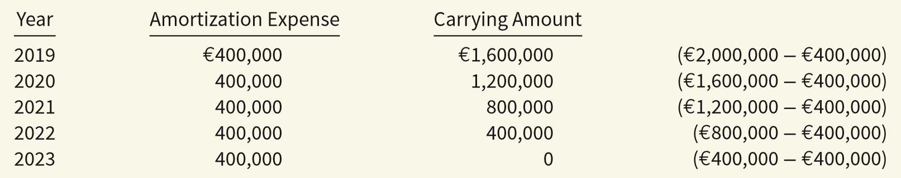
Impairment of Limited-Life Intangibles
Reversal of Impairment Loss 减值损失转回
Illustration: The carrying value of the patent after impairment is €2,000,000. Lerch’s amortization is €400,000 (€2000,000 ÷ 5) over the remaining five years of the patent’s life. The amortization expense and carrying amount after the impairment is shown below:
ILLUSTRATION 12.8
Post-Impairment Carrying Value of Patent
LO 4
Notes:
What happens if a review in a future year indicates that an intangible asset is no longer impaired because the recoverable amount of the asset is higher than the carrying amount?
In that case, the impairment loss may be reversed.

Slide 44
Impairment of Limited-Life Intangibles
Reversal of Impairment Loss 减值损失转回
Early in 2020, based on improving conditions in the market for shale-oil technology, Lerch remeasures the recoverable amount of the patent to be €1,750,000. In this case, Lerch reverses a portion of the recognized impairment loss.
Date | Account | Debit | Credit
Patents (€1,750,000 - €1,600,000) 150,000
无形资产减值准备——专利权
Recovery of Impairment Loss 150,000
资产减值损失
The recovery of the impairment loss is reported in the Other income and expense section of the income statement. The carrying value of the patent is now €1,750,000 (€1,600,000 + €150,000). Assuming the remaining life of the patent is four years, Lerch records €437,500 (€1,750,000 ÷ €4) of amortization expense in 2023.
LO 4

Slide 45
Impairment of Intangible Assets
Impairment of Indefinite-Life Intangibles Other than Goodwill
Should be tested for impairment at least annually.
Impairment test is the same as that for limited-life intangibles. That is,
compare the recoverable amount of the intangible asset with the asset’s carrying value.
If the recoverable amount is less than the carrying amount, the company recognizes an impairment.
LO 4

Slide 46
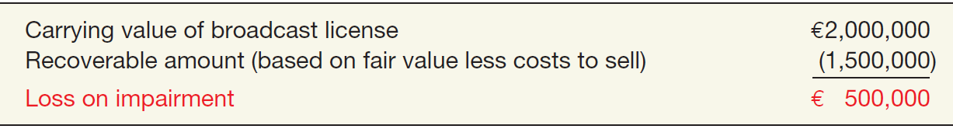
Impairment of Indefinite-Life Intangibles
Illustration: Arcon Radio purchased a broadcast license for €2,000,000. The license is renewable every 10 years. Arcon Radio has renewed the license with the GCC twice, at a minimal cost. Because it expects cash flows to last indefinitely, Arcon reports the license as an indefinite-life intangible asset. Recently, the GCC decided to auction these licenses to the highest bidder instead of renewing them. Based on recent auctions of similar licenses, Arcon Radio estimates the fair value less costs to sell (the recoverable amount) of its license to be €1,500,000.
ILLUSTRATION 12.9
Computation of Loss on Impairment of Broadcast License
LO 4

Slide 47
Impairment of Intangible Assets
Impairment of Goodwill 商誉减值
Companies must test goodwill at least annually.
Impairment test is conducted based on the cash-generating unit to which the goodwill is assigned.
Cash-generating unit = smallest identifiable group of assets that generate cash flow.
Estimation of the recoverable amount for goodwill impairments is usually based on value-in-use estimates.
Goodwill impairment loss reversals are not permitted.
LO 4
Notes:
However, because goodwill generates cash flows only in combination with other assets, the impairment test is conducted based on the cash-generating unit to which the goodwill is assigned.

Slide 48
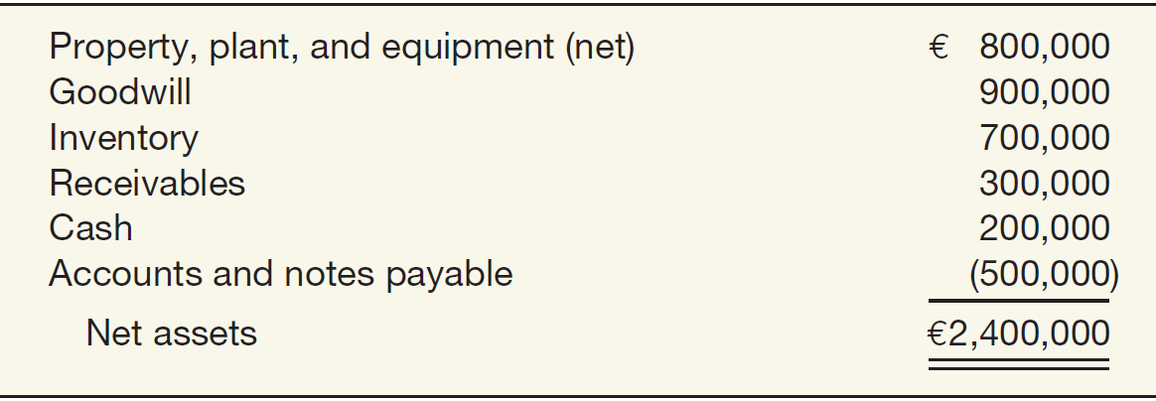
Impairment of Goodwill 商誉减值
Illustration: Kohlbuy AG has three divisions. It purchased one division, Pritt Products, four years ago for €2 million. Unfortunately, Pritt experienced operating losses over the last three quarters. Kohlbuy management is now reviewing the division (the cash-generating unit), for purposes of its annual impairment testing. Illustration 12.10 lists the Pritt Division’s net assets, including the associated goodwill of €900,000 from the purchase.
ILLUSTRATION 12.10
LO 4

Slide 49
Impairment of Goodwill
Kohlbuy determines the recoverable amount for the Pritt Division to be €2,800,000, based on a value-in-use estimate.
€2,400,000
€2,800,000
No Impairment
Unknown
€2,800,000
LO 4

Slide 50
Impairment of Goodwill
Assume that the recoverable amount for the Pritt Division is €1,900,000 instead of €2,800,000.
€500,000 Impairment Loss
€2,400,000
€1,900,000
Unknown
€1,900,000
LO 4
LO 5

Slide 51
Impairment of Goodwill
Assume that the recoverable amount for the Pritt Division is €1,900,000 instead of €2,800,000.
€500,000 Impairment Loss
€2,400,000
€1,900,000
Kohlbuy makes the following entry to record the impairment.
Date | Account | Debit | Credit
Loss on Impairment 资产减值损失 500,000
Goodwill 商誉减值准备 500,000
Unknown
$1,900,000
LO 4
LO 5
Notes:
In the Kohlbuy case, the entire impairment loss is allocated to goodwill. If the impairment loss exceeds the carrying value of the goodwill, Kohlbuy allocates the impairment loss to the goodwill and other assets as follows: (1) reduce the goodwill to zero and (2) allocate any remaining impairment loss to the other assets on the basis of their relative carrying amounts. In this case, Kohlbuy follows the impairment guidelines for long-lived assets, as discussed in Chapter 11. If these assets are evaluated for impairment on an individual basis, impairment losses may have been recorded on these assets as part of that process. Alternatively, the Kohlbuy example could represent a situation in which the other assets are evaluated at the cash-generating-unit level. These procedures are complex and beyond the scope of this textbook.

Slide 52
Presentation of Intangible Assets
Statement of Financial Position
Companies should report as a separate item all intangible assets other than goodwill.
Reporting is similar to the reporting of property, plant, and equipment.
Contra accounts are not normally shown for intangibles.
LO 4

Slide 53
Presentation of Intangible Assets
Income Statement
Companies should report
amortization expense and
impairment losses and reversals
for intangible assets other than goodwill separately in net income (usually in the operating section).
Notes to the financial statements should include the amortization expense for each type of asset.
LO 4

Slide 54
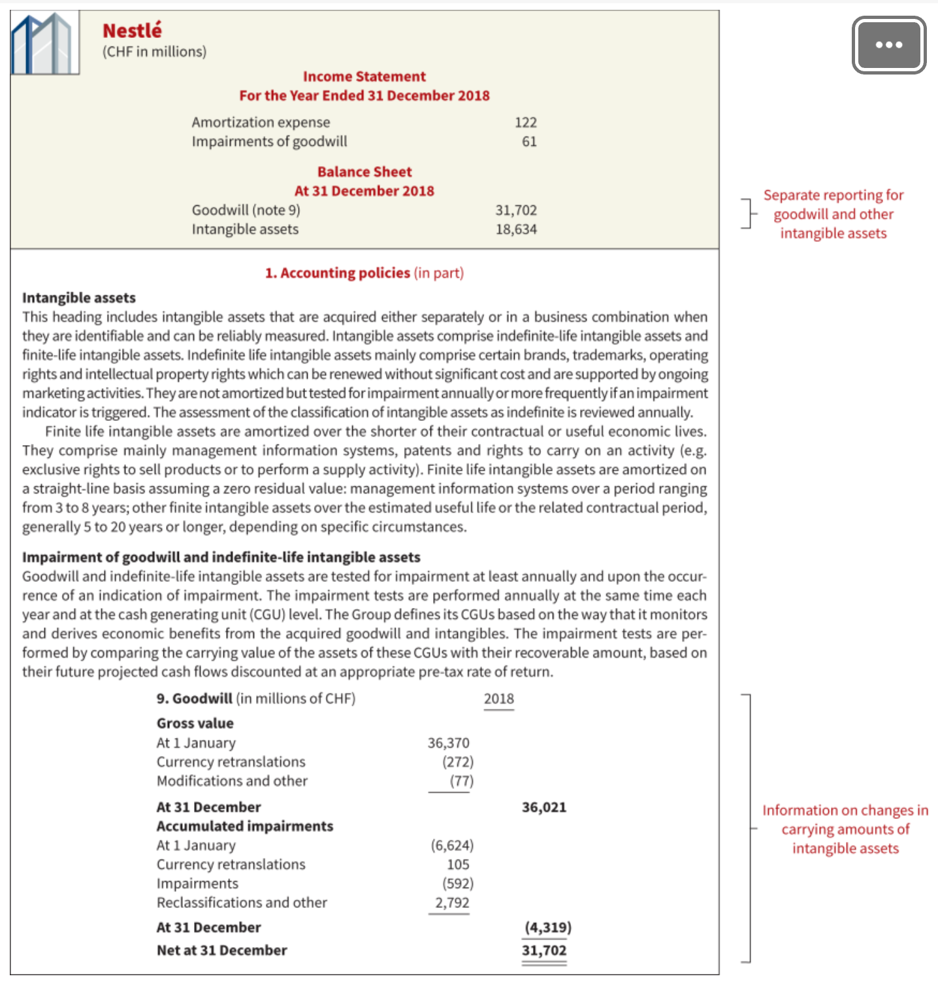
Presentation of Intangible Assets
The reporting of intangible assets is similar to the reporting of property, plant, and equipment.
ILLUSTRATION 12.12
Nestlé’s Intangible Asset Disclosures
Unknown
$1,900,000
LO 4
LO 5

Slide 55
LEARNING OBJECTIVE 5
Describe the accounting and presentation for research and development and similar costs.

Slide 56
Research and Development Costs 研发支出
Research and development (R&D) costs are not in themselves intangible assets.
Frequently results in the development of patents or copyrights such as new
product,
process,
idea,
formula,
composition, or
literary work.
LO 5

Slide 57
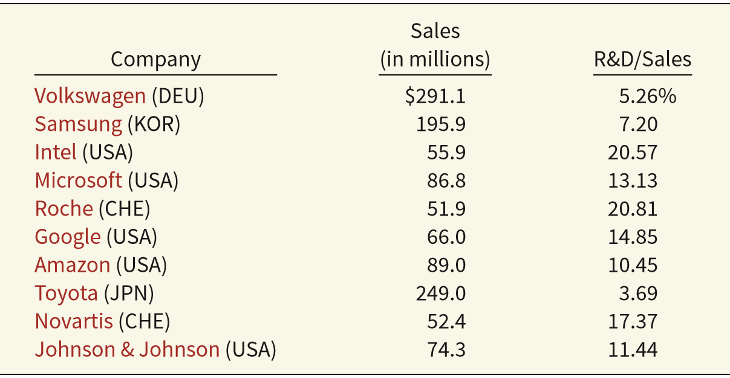
Research and Development Costs
Companies spend considerable sums on research and development.
ILLUSTRATION 12.13
R&D Outlays, as a Percentage of Sales
LO 5

Slide 58
Research and Development Costs
Research costs 研究支出 must be expensed as incurred.
Development costs 开发支出 may or may not be expensed as incurred.
Capitalization begins when the project is far enough along in the process such that the economic benefits of the R&D project will flow to the company (the project is economically viable 经济可行性).
LO 5

Slide 59
Research and Development Costs
All of the following criteria must be met to begin capitalizing development costs into the carrying value of the related intangible: (1) the project achieves technical feasibility of completing the intangible asset so that it will be available for use or sale; (2) the company intends, and has the ability, to complete the intangible asset and use or sell it; (3) the intangible asset will generate probable future economic benefits (there is a market for the asset or the output of the asset); (4) the company has adequate technical, financial, and other resources to complete the development of the intangible asset; and (5) the company can measure reliably the development costs associated with the intangible asset to be developed.
LO 5

Slide 60
Research and Development Costs
Identifying R & D Activities 研发活动
ILLUSTRATION 12.14
Research Activities versus Development Activities
Research Activities 研究活动
Original and planned investigation undertaken with the prospect of gaining new scientific or technical knowledge and understanding.
Examples
Laboratory research aimed at discovery of new knowledge; searching for applications of new research findings.
Development Activities 开发活动
Application of research findings or other
knowledge to a plan or design for the
production of new or substantially improved materials, devices, products, processes, systems, or services before the start of commercial production or use.
Examples
Conceptual formulation and design of possible product or process alternatives; construction of prototypes and
operation of pilot plants.
LO 5

Slide 61
Research and Development Costs
Accounting for R & D Activities
Costs Associated with R&D Activities:
Materials, equipment, and facilities.
Expense the entire costs, unless the items have alternative future uses (in other projects or otherwise).
Personnel. Expense as incurred salaries, wages, and other related costs of personnel engaged in R&D.
Purchased intangibles. Recognize and measure at fair value.
Contract Services. Expense the costs of services performed by others in connection with R&D as incurred.
Indirect Costs.
LO 5
Notes:
In the Kohlbuy case, the entire impairment loss is allocated to goodwill. If the impairment loss exceeds the carrying value of the goodwill, Kohlbuy allocates the impairment loss to the goodwill and other assets as follows: (1) reduce the goodwill to zero and (2) allocate any remaining impairment loss to the other assets on the basis of their relative carrying amounts.

Slide 62
Accounting for R & D Activities
Illustration 12.15 Sample R&D Expenditures and Their Accounting Treatment.
Type of Expenditure
Accounting Treatment
Construction of long-range research facility for use in current and future projects (three-story, 400,000-square-foot building).
Acquisition of R&D equipment for use on current project only.
Acquisition of machinery for use on current and future R&D projects.
Capitalize and depreciate as R&D expense.
Expense immediately as R&D.
Capitalize and depreciate as R&D expense.
LO 5

Slide 63
Accounting for R & D Activities
Type of Expenditure
Accounting Treatment
Purchase of materials for use on current and future R&D projects.
Salaries of research staff designing new laser bone scanner.
Research costs incurred under contract with New Horizon, Inc., and billable monthly.
Material, labor, and overhead costs of prototype laser scanner (economic viability not achieved).
Inventory and allocate to R&D projects; expense as consumed.
Expense immediately as R&D.
Record as a payable. Expense as R&D.
Expense immediately as R&D.
LO 5

Slide 64
Accounting for R & D Activities
Type of Expenditure
Accounting Treatment
Costs of testing prototype and design modifications (economic viability not achieved).
Legal fees to obtain patent on new laser scanner.
Executive salaries.
Cost of marketing research to promote new laser scanner.
Expense immediately as R&D.
Capitalize as patent and amortize to overhead as part of cost of goods manufactured.
Expense as operating expense.
Expense as operating expense.
LO 5

Slide 65
Accounting for R & D Activities
Type of Expenditure
Accounting Treatment
Engineering costs incurred to advance the laser scanner to full production stage (economic viability achieved).
Costs of successfully defending patent on laser scanner.
Commissions to sales staff marketing new laser scanner.
Capitalize as R&D.
Expense as legal fees.
Expense as operating expense. (selling expense)
LO 5

Slide 66
Research and Development Costs
Costs Similar to R & D Costs
Start-up costs for a new operation.
Initial operating losses.
Advertising costs.
These costs are expensed as incurred, similar to the accounting for R&D costs.
LO 5

Slide 67
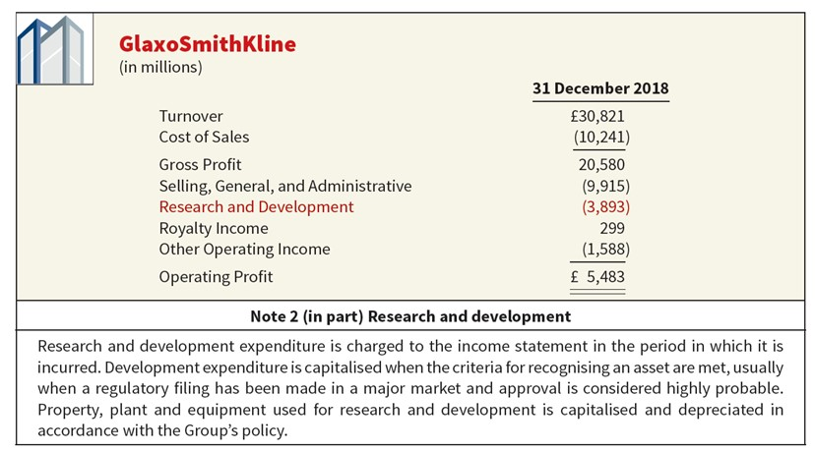
Presentation of R&D Costs
Companies should disclose the total R&D costs charged to expense each period.
ILLUSTRATION 12.16
R&D Reporting
LO 5

Slide 68
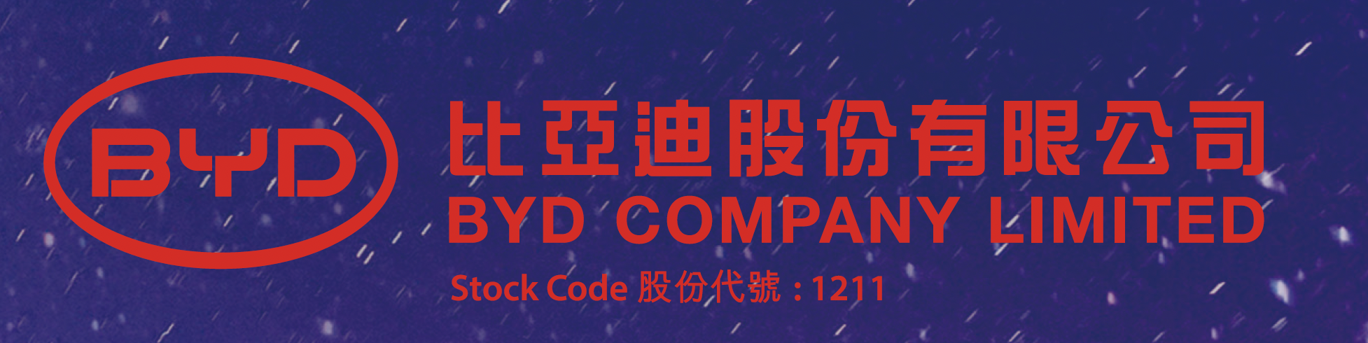
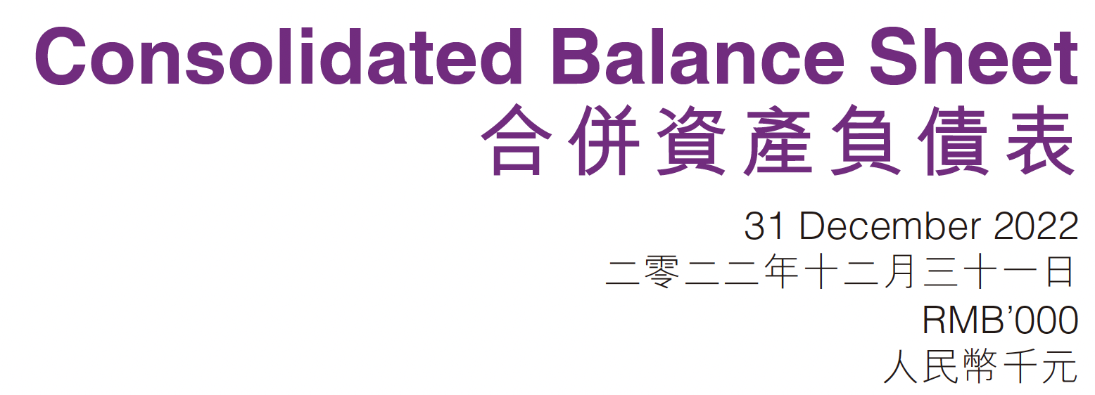
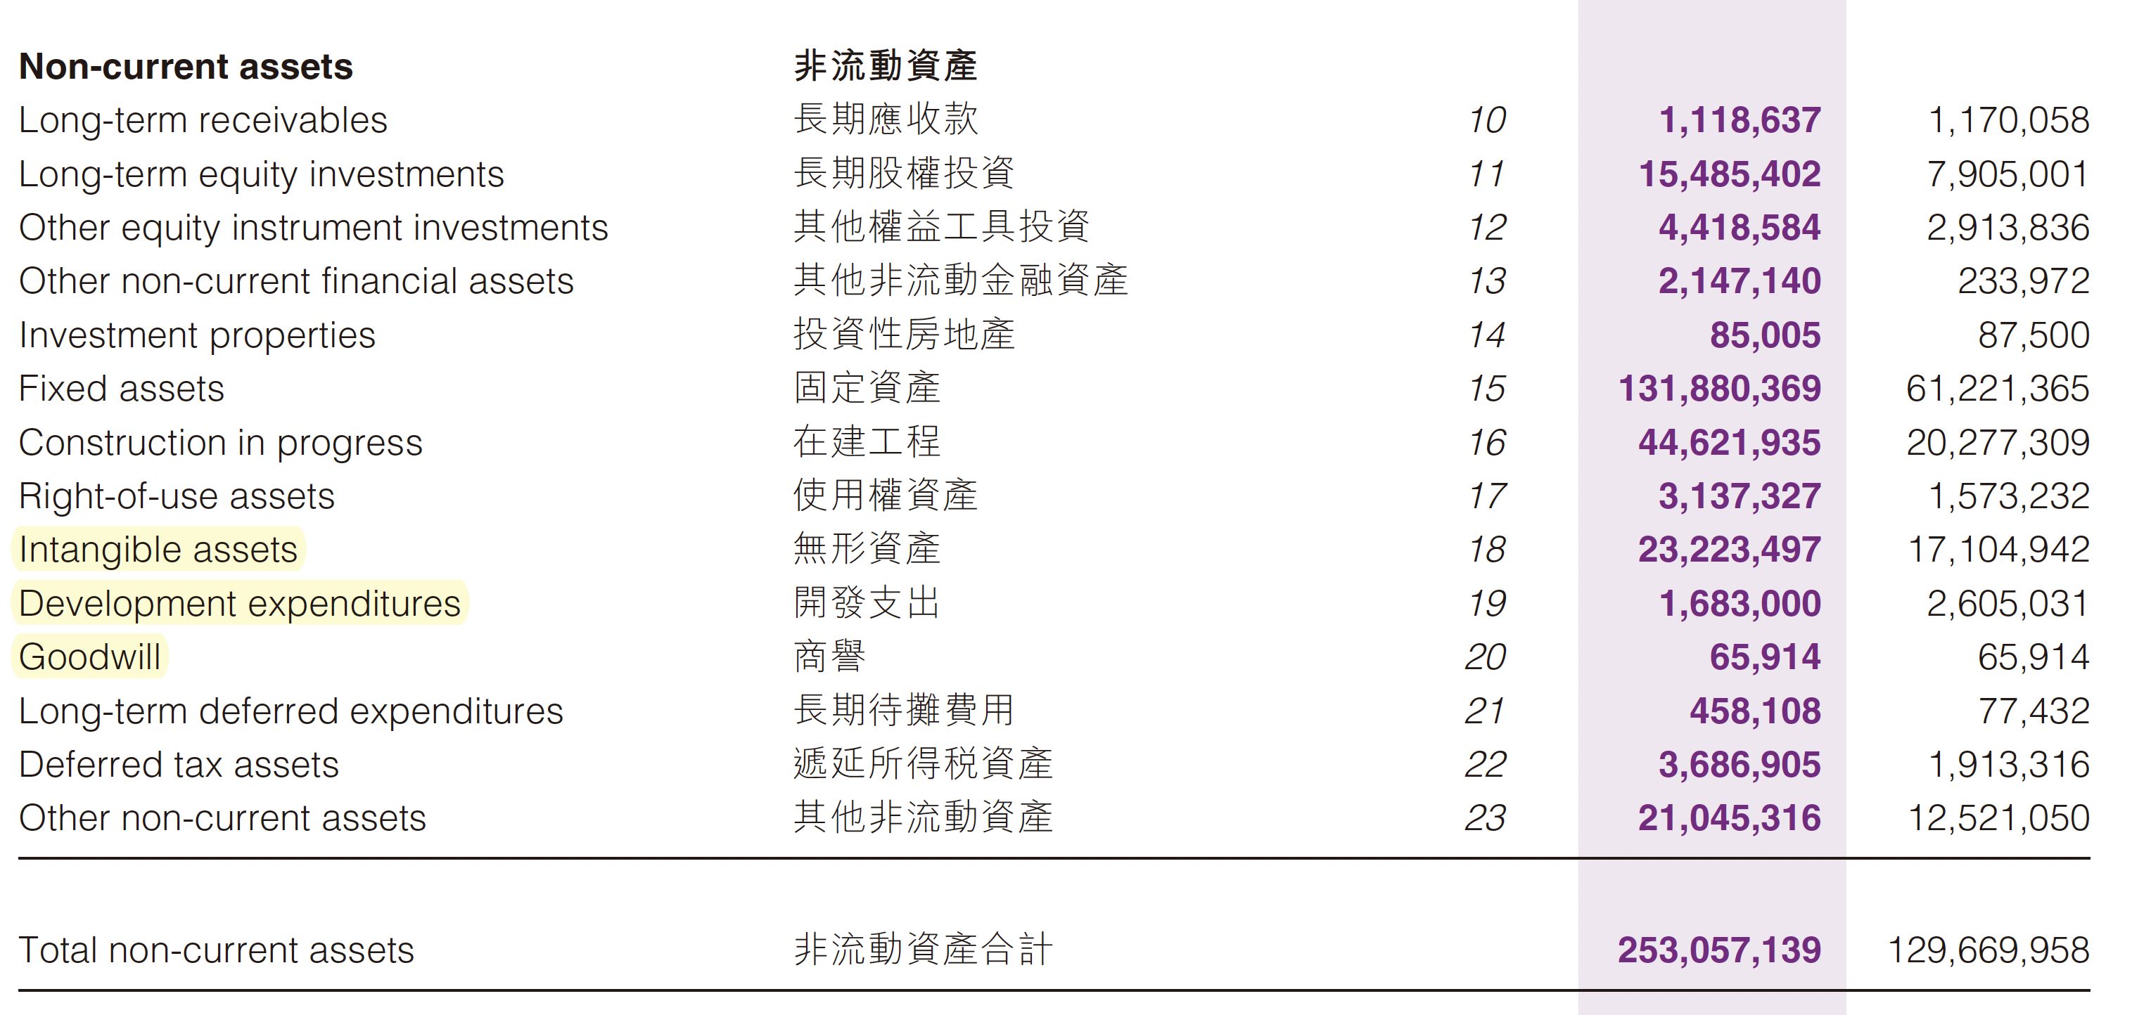

Slide 69
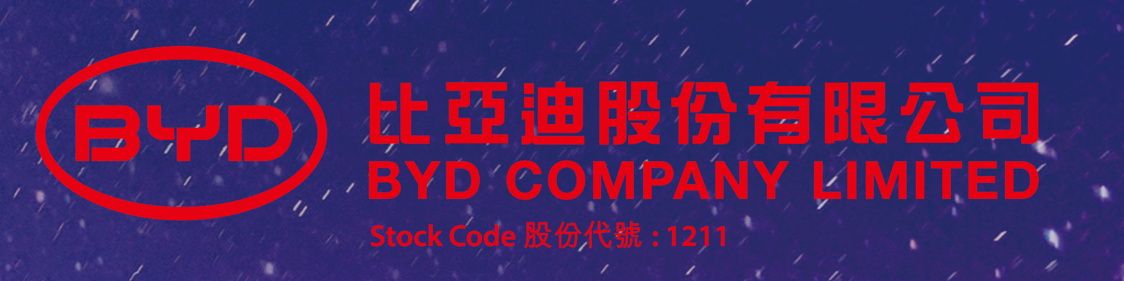
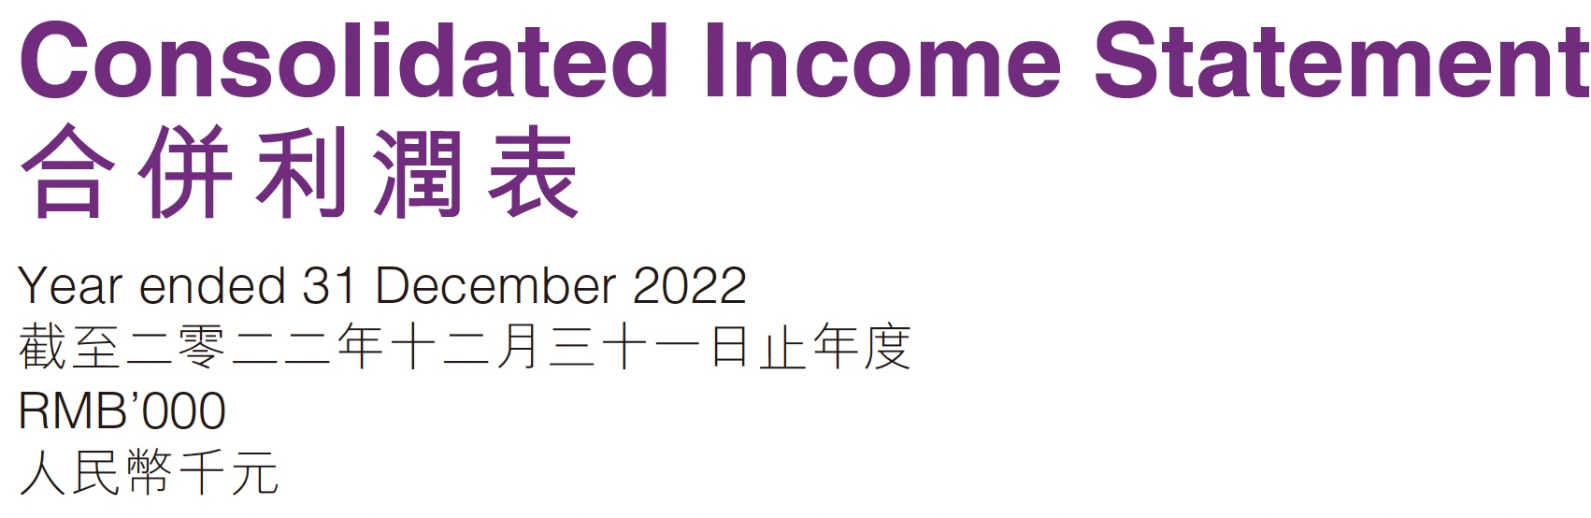
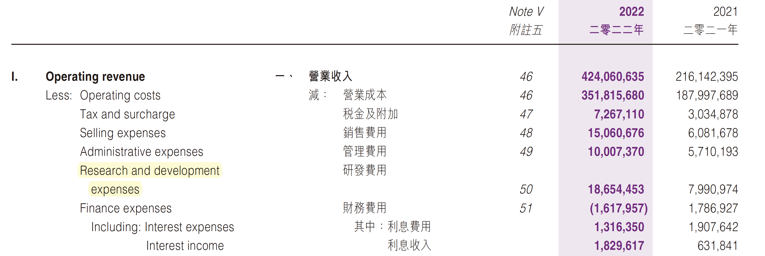

Slide 70
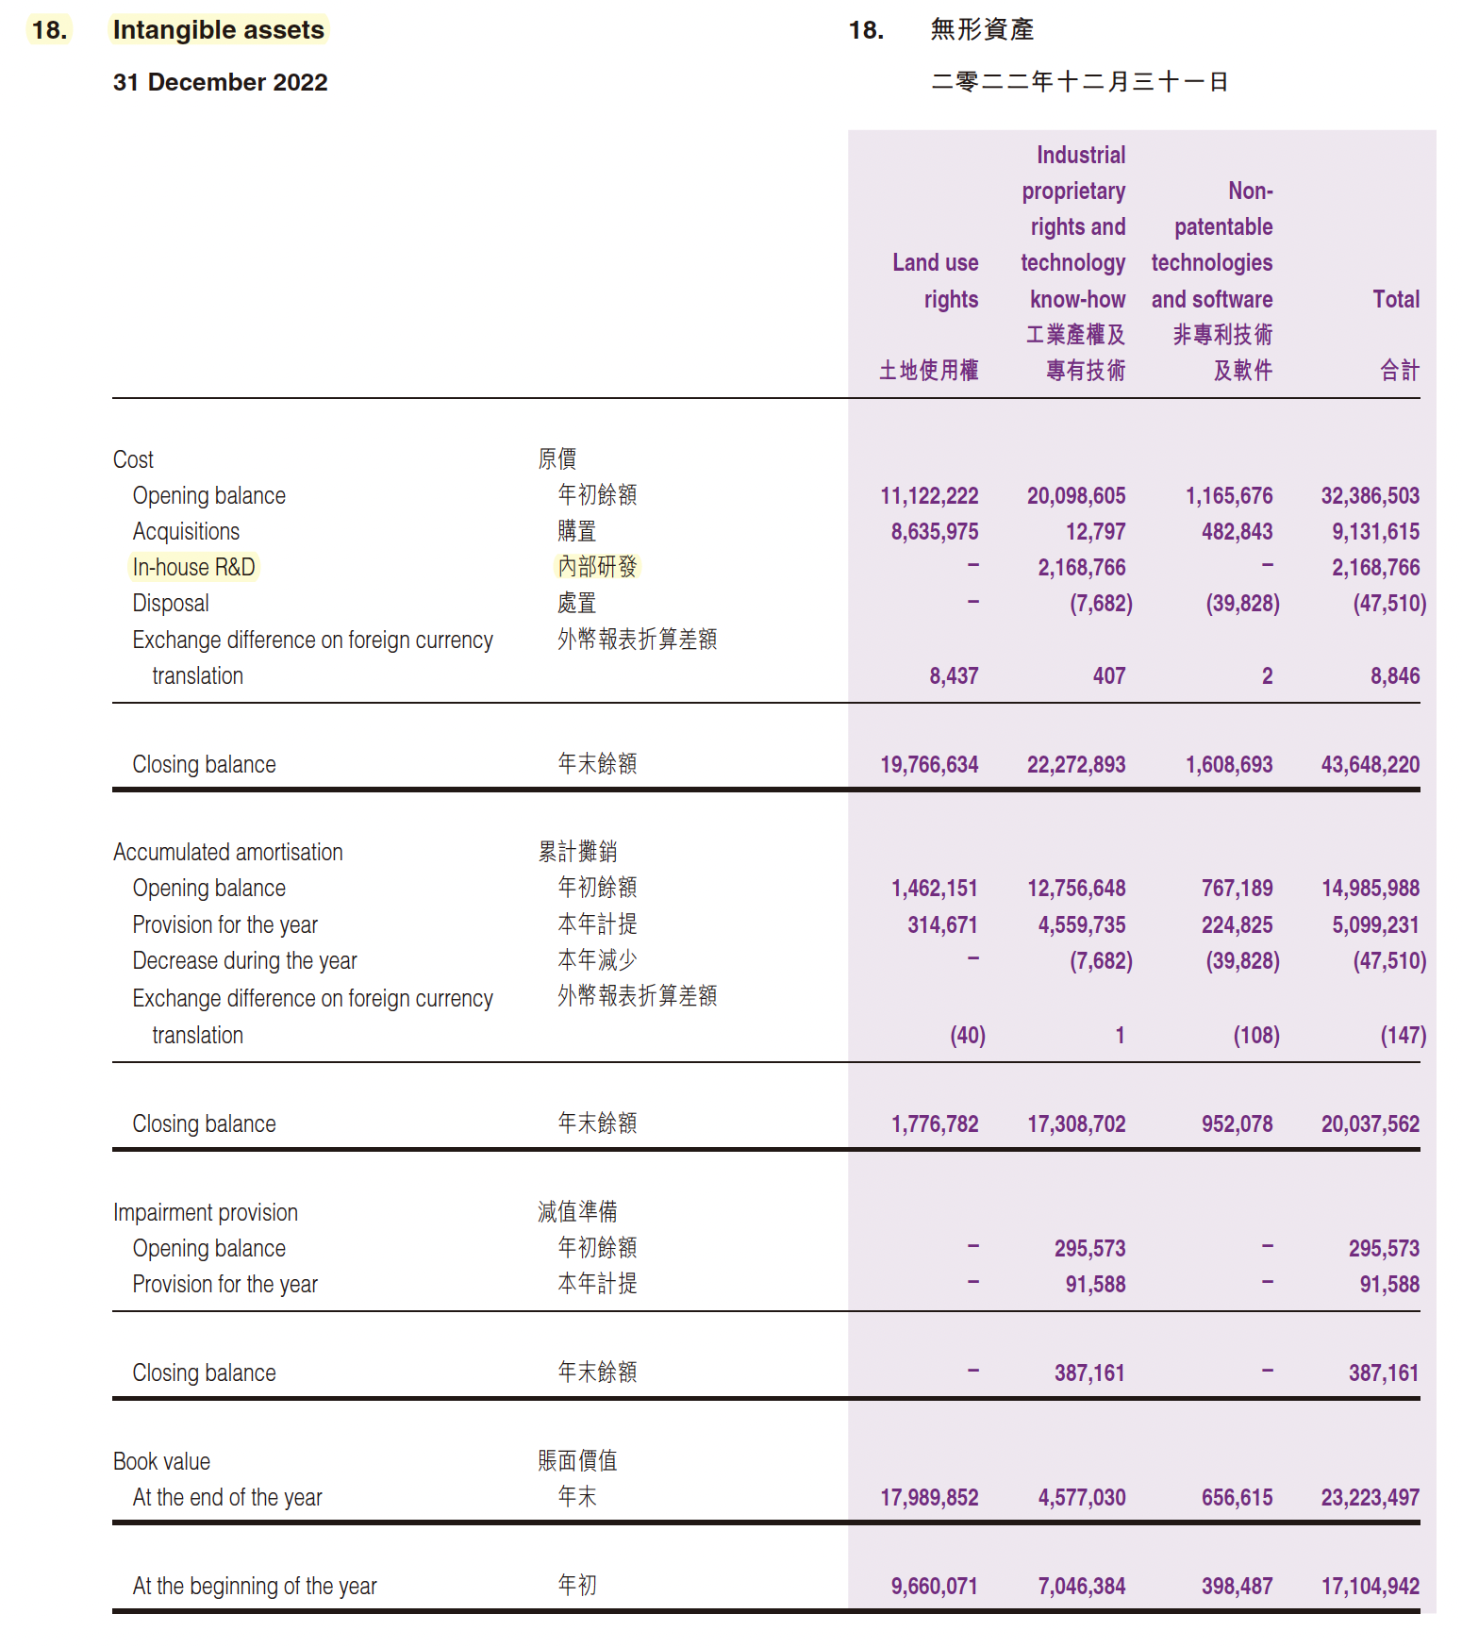

Slide 71
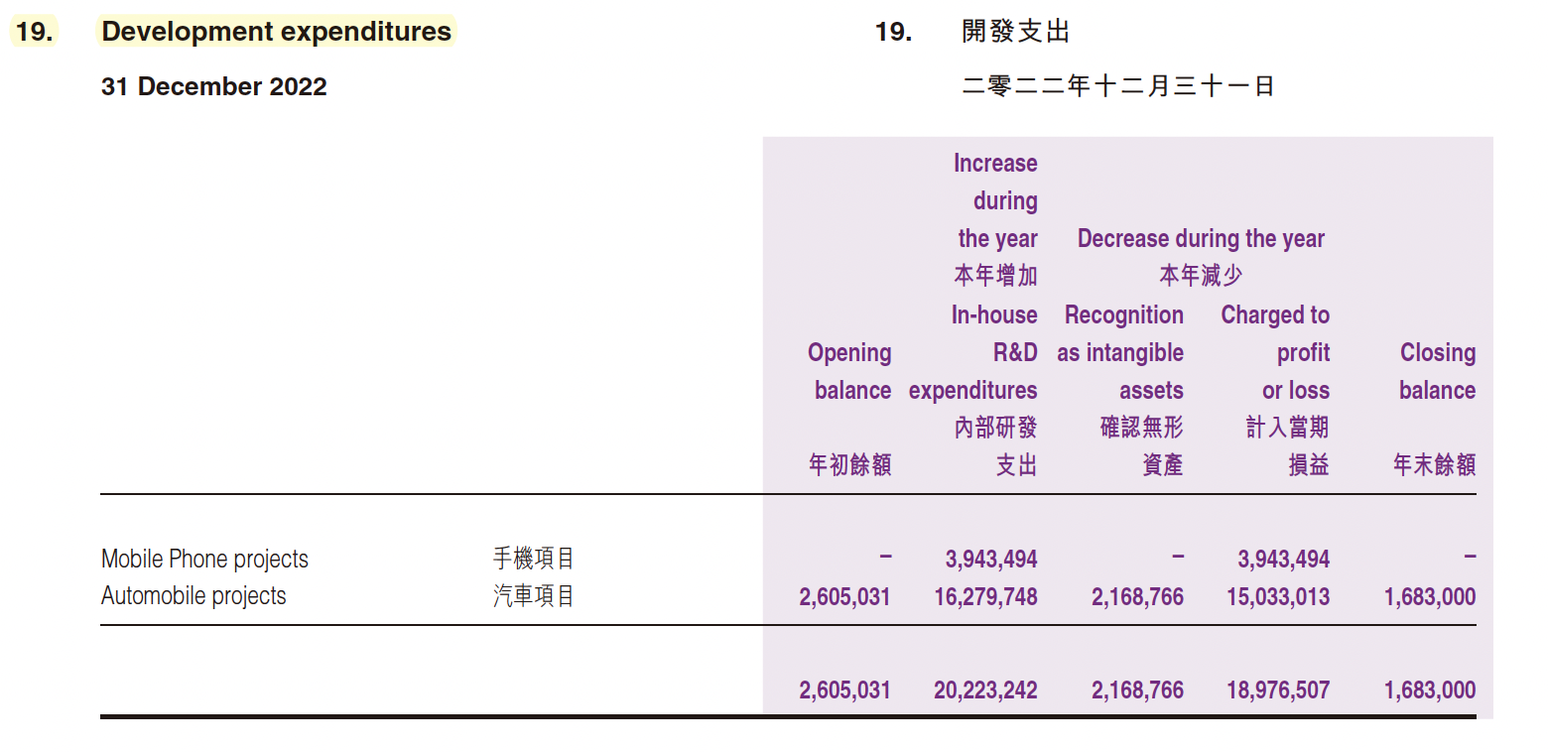
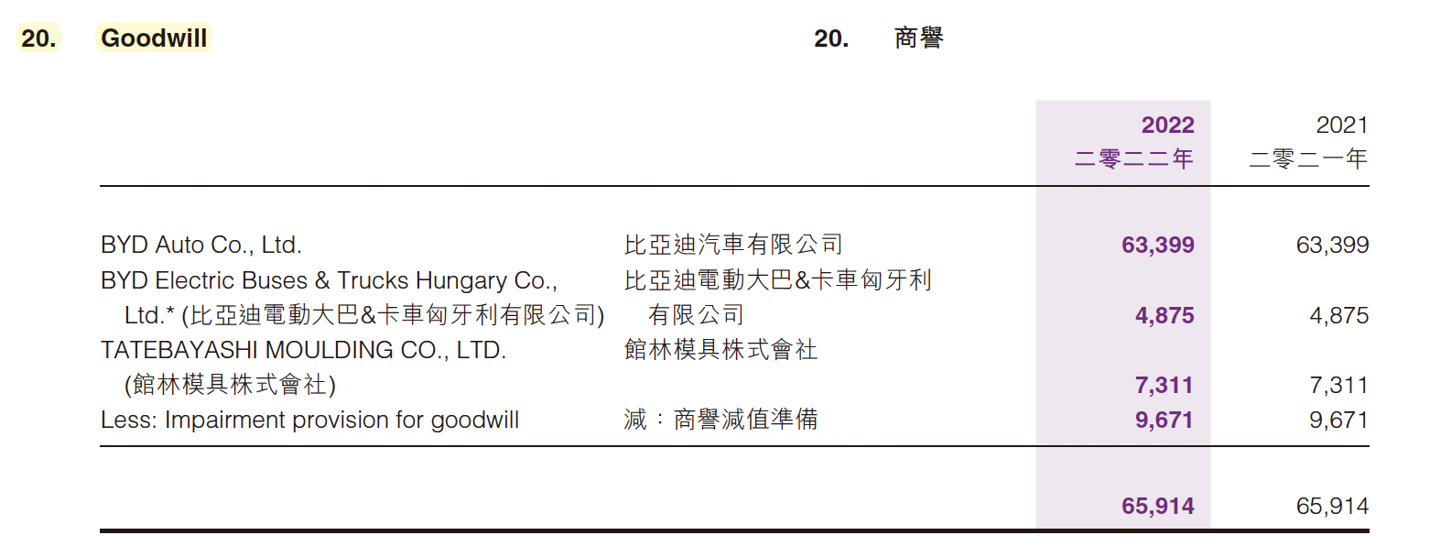

Slide 72
Question
数据是数字经济的关键要素。近年来，中国产业数字化程度显著提高，数据资源对于企业特别是相关数据企业的价值创造日益发挥着重要作用。
数据资源是否可以作为资产确认？怎样进行计量？能否作为会计上的资产“入表”？

Slide 73


感谢您的参与！
THE HITSZ
SCHOOL OF ECONOMICS
AND MANAGEMENT

